Slide 1
WELCOME, FISH FRIENDS!
SEPTEMBER 17, 2019

Slide 2
TODAY’S AGENDA
Fish of the week
Upcoming Events
Internship Opportunity
Speaker: Dr. Neil Ringler

Slide 3
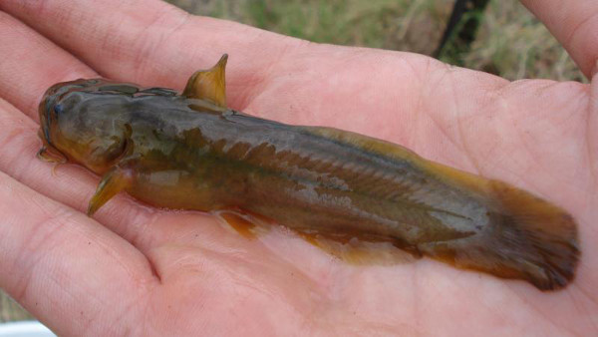
Fish of the Week!!!

Slide 4
Tadpole Madtom Noturus gyrinus
Commonly found in slow moving streams with dense vegetation, and the shallows of lakes
Opportunistic feeders, they eat a wide range of small invertebrates
Have large serrated spines in the both the dorsal fin and the pectorals
These spines are attached to noxious venom glands to further deter large predators
A study done by the University of Michigan found this spine/venom combo to be extremely successful in protecting the Tadpole Madtom
Largemouth Bass will actually “spit” the madtom out of its mouth as soon as it gets pricked by the spines
However, the venom glands are quickly depleted after several attacks and require time to replenish
https://jeb.biologists.org/content/215/11/i.2

Slide 5
Upcoming Events
MOVIE NIGHT!
Wednesday 9/18, 6pm in Nifkin Lounge.
Showing: DamNation
GLOBAL CLIMATE STRIKE
Friday 9/20, 11:30am at Forman Park (717 E Genesee)
Syracuse Climate Strike
https://strikewithus.org/?referrer=group-350org-network&source=350org-network

Slide 6
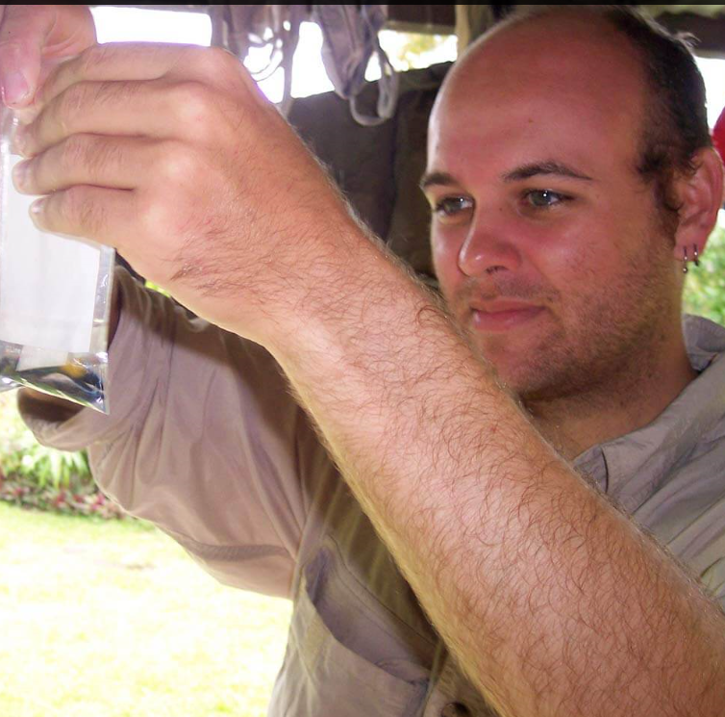
Upcoming Events
SHORELINE CLEANUP!
Sunday 9/22, 12-3pm. SIGN UP!
Meet at Onondaga Lake Lounge
(Park at Destiny)
NEXT WEEK
Dr. Joshua Drew, tropical marine conservation

Slide 7
Coming soon!
USA meetings--still need a rep!
10/3 at 6pm in Nifkin
10/31 at 6pm in Gateway
11/21 at 6pm in Gateway
9/24 EFB/AFS Mixer! 4-6:30 in 408 Baker
10/5 ESF Day of Service
10/31 Data management seminar

Slide 8
INTERNSHIP OPPORTUNITY
New USGS research biologist (and ESF alum) Dr. Brian O' Malley is looking for an intern to assist with a cisco morphometrics project .
Probably minimum 4-ish hrs/week, or more if the student is really industrious.
They would train at Oswego, then could work remotely, occasionally popping in to the office to check-in.

Slide 9
Project: Comparison of TM vs GM approaches for discriminating C. artedi morphs
TM = Traditional morphometrics; linear measurements, used for taxonomy; caliper
GM = Geometric morphometrics; shape analysis; digital images
Which method is more sensitive? What are the most appropriate GM landmarks for cisco morphs? How does each method perform in a mixed-morph sample?
Shorthead morph –
Harbor Island Bay, Lake Huron
Co-investigators: GLFC, USFWS-Alpena, USGS Ann Arbor, U. Wisc.

Slide 10
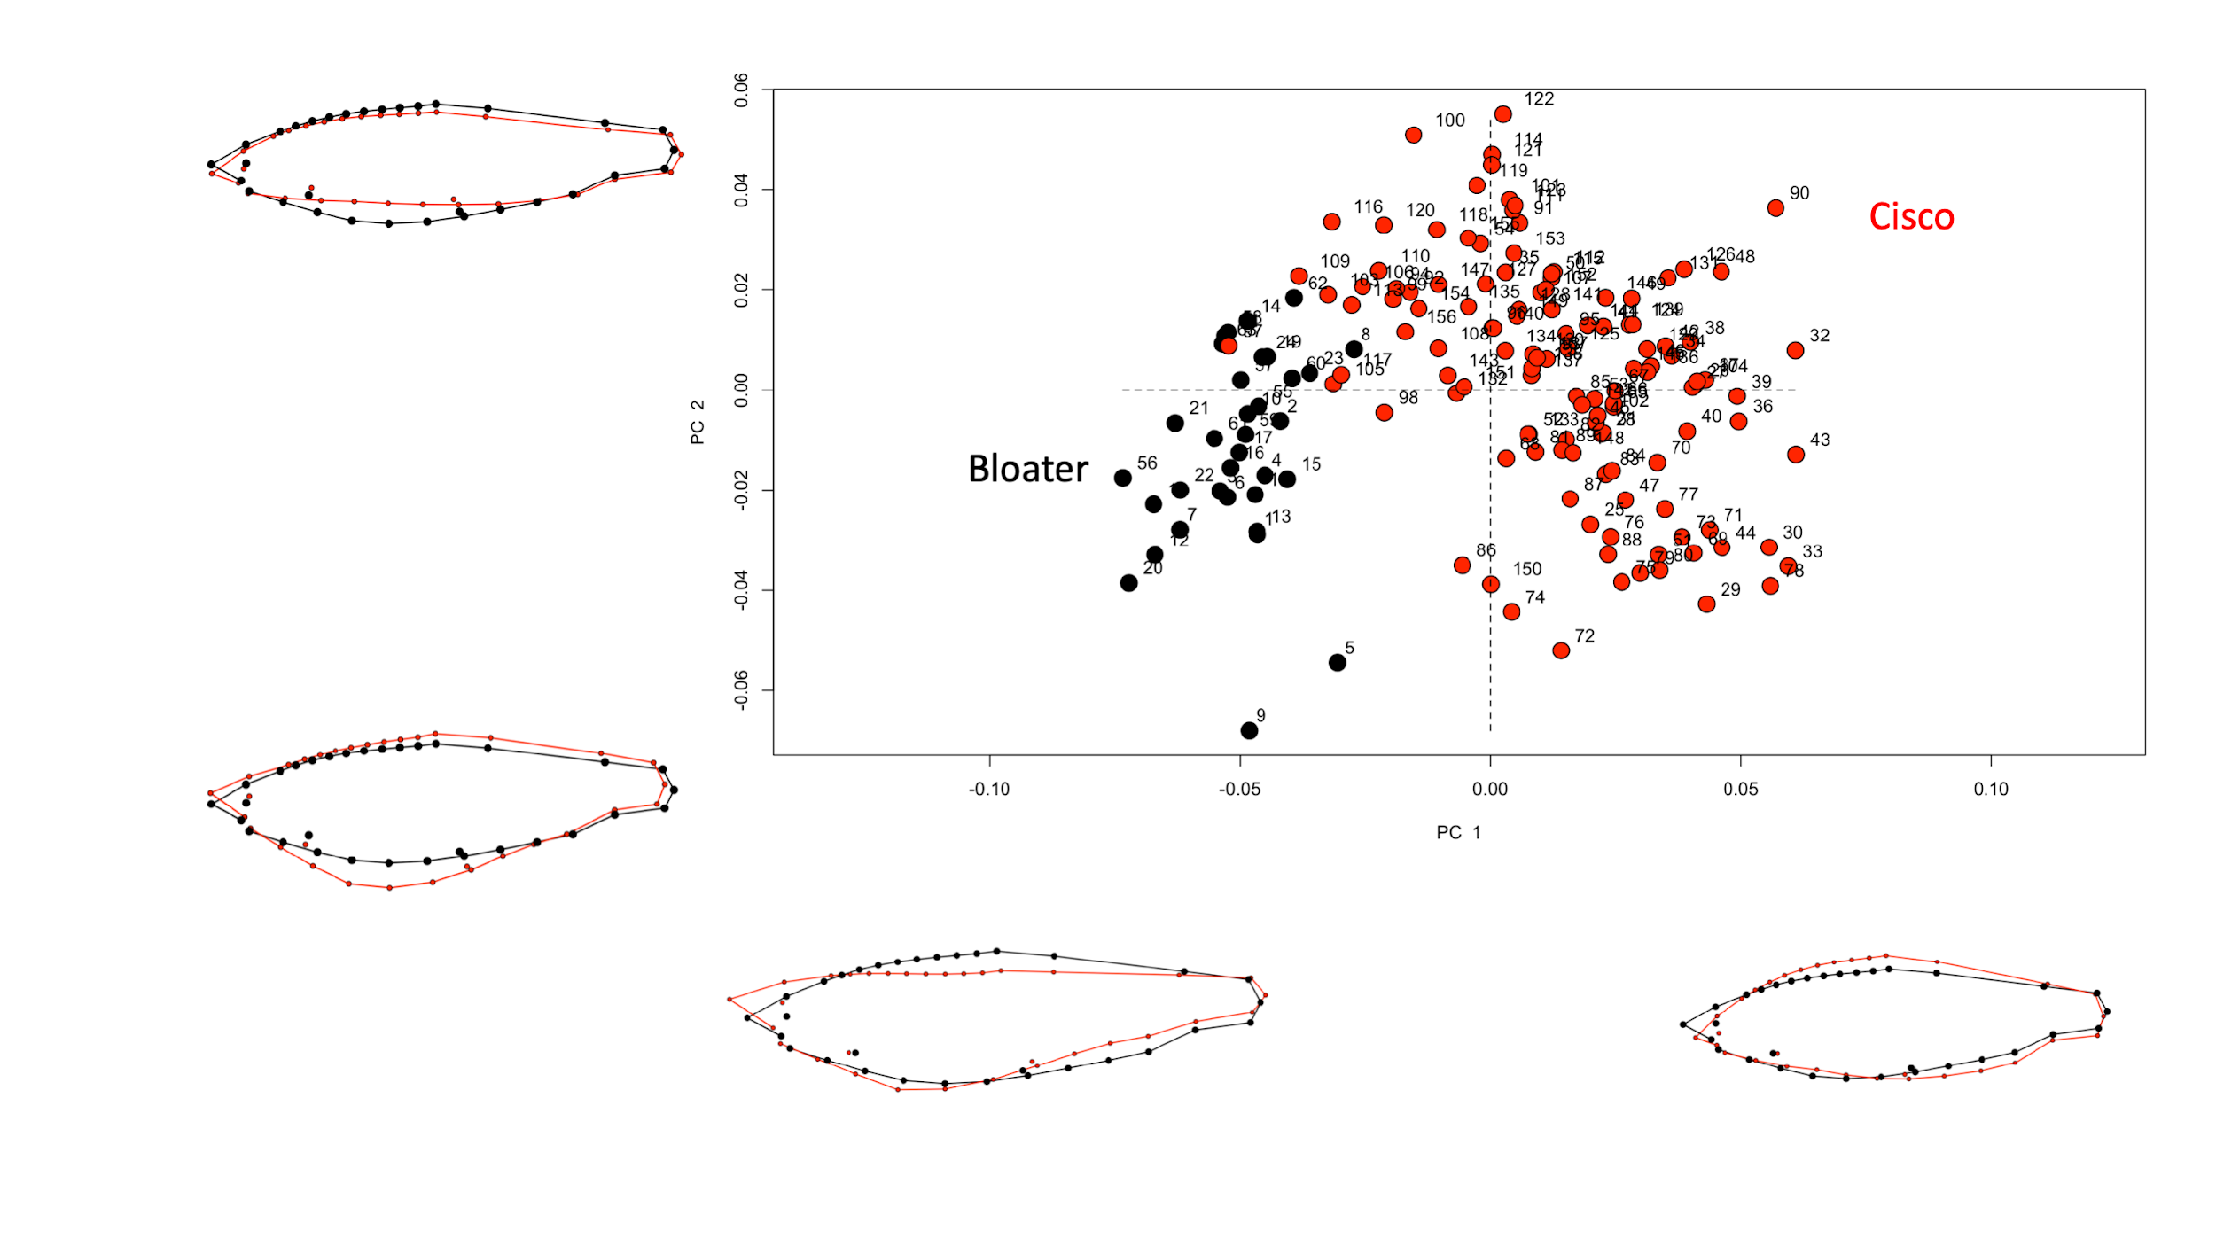
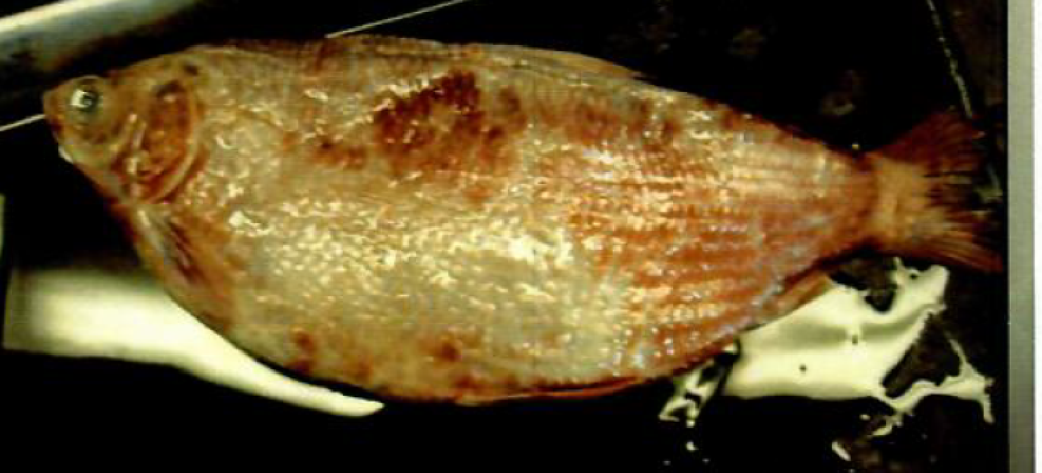
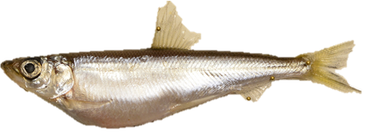
C. artedi (Typical artedi)
C. artedi (Shorthead morph)
C. artedi (Manitoulinus morph)
C. artedi (Albus morph)
*** Seeking a motivated student to help digitize and process (landmark analysis) images of coregonines for geometric morphometric study of historical and contemporary morphs ***
C. artedi (Cisco) morphs to separate:
Typical artedi (Historical samples from Koelz 1929)
Shorthead (North Channel, L. Huron)
Manitoulinus (Les Cheneaux Islands, L. Huron)
Albus? Possibly some in L. Ontario
C. hoyi (Bloater)
Thought to be just one morph
C. hoyi (Bloater)

Slide 11
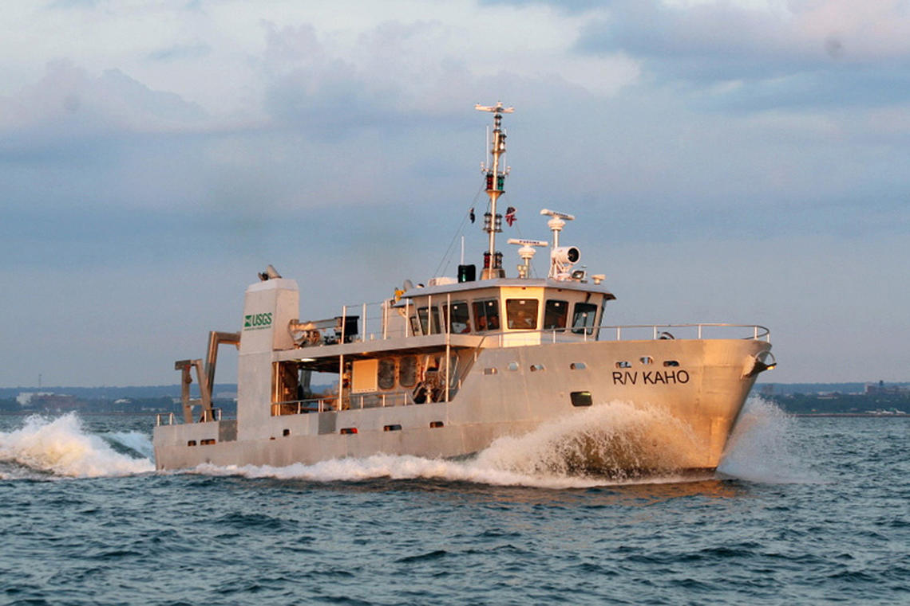
Preferred qualifications
Basic knowledge of R statistical software or desire to learn
Ichthyology
Attention to details, ability to learn how digitize fish pictures and manage data
Willingness to learn about morphology, how to analyze data, and communicate findings through scientific talks and publication
If interested please email a brief cover letter and resume, that highlights relevant coursework and any research experience you might have, and what you hope to get out of this experience :
Brian O’Malley
bomalley@usgs.gov
USGS Great Lakes Science Center
Lake Ontario Biological Station
Oswego, NY
See: https://www.usgs.gov/centers/glsc to learn more about USGS
RV Kaho

Slide 12
Dr. Neil Ringler
nhringle@esf.edu
Illick 224
Distinguished Teaching Professor, Vice Provost, and Executive Director of ESF Onondaga Lake Science Center
Fish ecology and behavior, foraging behavior of fishes, salmon reproduction, vertebrate anatomy, aquatic insect ecology, stream ecology and management, aquatic and fisheries restoration, aquatic entomology
COURSES TAUGHT (not necessarily currently) CURRENT STUDENTS
EFB 132 Orientation Seminar: Environmental and Forest Biology Mike Connerton
EFB 385 Comparative Vertebrate Anatomy Michaela Kenward
EFB 388 Ecology of Adirondack Fishes Carrick Palmer
EFB 554 Aquatic Entomology Joe Sullivan
EFB 796 Topics in Environmental and Forest Biology: Animal Flight Jane VanVessem
Notes:
CalState LongBeach, Oregon State, UMichigan
ESF since 1975, 50 pubs
Pilot, army

Slide 13
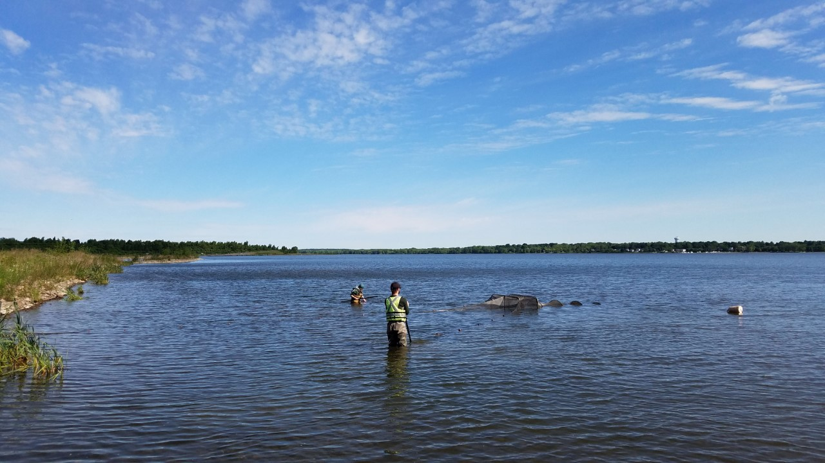
SEE YOU NEXT WEEK!
SPEAKER: Dr. Joshua Drew, ESF

