Slide 1
WELCOME, FISH FRIENDS!
SEPTEMBER 24, 2019

Slide 2
TODAY’S AGENDA
Fish of the week
Week in Review
Upcoming Events
Speaker: Dr. Joshua Drew

Slide 3
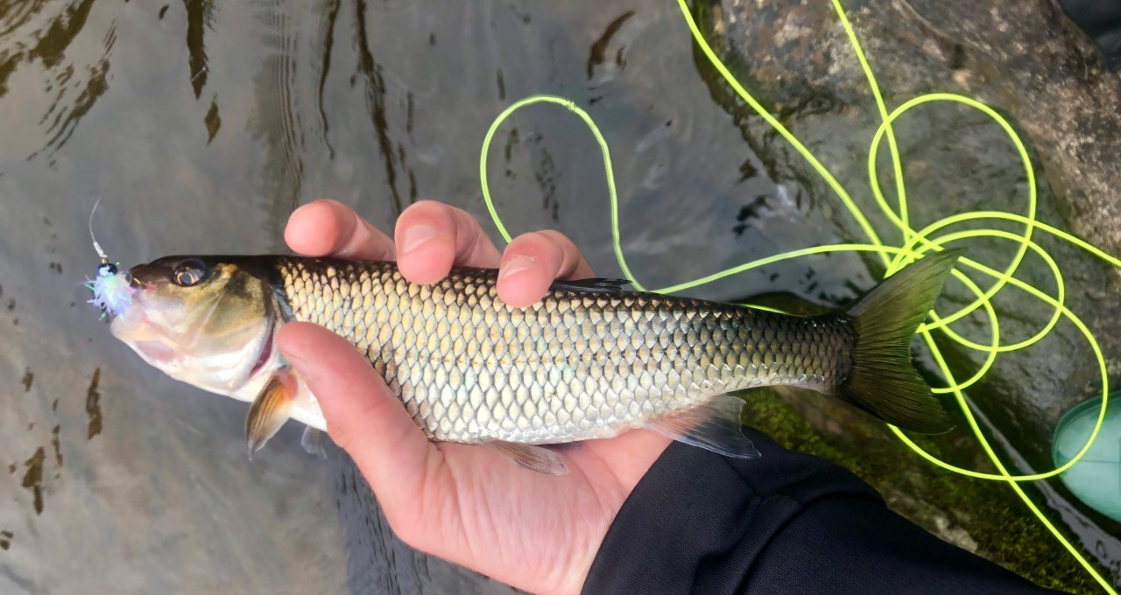
Fish of the Week!!!

Slide 4
Fallfish Semotilus corporalis
Largest native NYS minnow
Feed of invertebrates and small fish
In spring, the males pick up rocks in their mouth, carry them upstream, and build a round nest 4ft wide 1.5ft tall
They are communal spawners
Small fallfish are often confused with their close relative the creek chub
The NYS record is 19 inches!
https://www.dec.ny.gov/animals/7040.html

Slide 5
That Was the Week
Movie
SHOWED: DamNation (2014)
Attendance: 5
Climate strike
Hundreds!
Stream cleanup
Onondaga Creekwalk
Attendance: 4 ESF + 6
Results:

Slide 6
Upcoming Events
EFB/AFS MIXER
TONIGHT! 9/24, 4-6:30pm in 408 Baker
Food and drinks will be provided
Program details, some fun, making sure everyone knows each other
ESF Graduate and Professional School Fair
Tuesday, September 24, 11-1:30, Gateway THAT’S NOW

Slide 7
Upcoming Events
Carpenters Brook Fish Hatchery Sportsmans Days
Saturday, 9/28 and Sunday, 9/29
6 - 8 students to help with the fishing program and some may help with the canoes. Sign up.
10/1 ESF Fall Career Fair, 10:30-2, Gateway Center
10/3 USA Meeting (rep?)
10/5 ESF Day of Service
10/10 Fishing with Electricity (and John Farrell)
10/11-13 ESF Family Weekend (Sat 10/12 activities fair 11am-2pm)
10/16 Movie Night with AFS
10/31 Data Management Seminar

Slide 8
Upcoming Events
10/14 Indigenous Peoples Day
Practical electrofishing
Tunison Lab tour
LOBS tour
Classroom outreach
Buoy auction
More at Carpenters Brook
ericstanczyk@ongov.net
NEXT WEEK
Eden Zickler,
Internship experiences
ANYBODY GOING FISHING?

Slide 9
Dr. Joshua Drew
jadrew@esf.edu
Illick 332
@Drew_Lab
Assistant Professor EFB since August 2019
Vertebrate conservation biology at the intersection of human and natural systems
Columbia University
American Museum of Natural History
East West University
Field Museum
COURSES TAUGHT (not necessarily currently)
Conservation Biology Thesis Development Seminar Anthropocene Conservation
Historical Ecology Marine Conservation Biology
Ichthyology Environmental Biology Senior Seminar in Conservation
Coastal Ecology History of Life
Cellular Biology Phylogenetics First Year Writing Seminar

